Slide 1
Naming Compounds
Compounds

Slide 2
Guided Instruction: Naming Compounds

Slide 3
Review: What is an ionic compound?
Formed when electrons are transferred between a metal and nonmetal

Slide 4
Review: What is a covalent compound?
Formed when electrons are shared between a nonmetals

Slide 5
A. Naming covalent compounds
Use a prefix to indicate the number of atoms of each element
# of atoms | prefix
1 | mono-
2 | di-
3 | tri-
4 | tetra-
5 | penta-
6 | hexa-

Slide 6
A. Naming covalent compounds
2. Replace the ending of the 2nd element with –ide.
Count 2 vowels back from the end of the nonmetal and remove all those letters
Add ide
Ex = N₂O₃
# of atoms | prefix
1 | mono-
2 | di-
3 | tri-
4 | tetra-
5 | penta-
6 | hexa-

Slide 7
B. Naming covalent compounds
2. Replace the ending of the 2nd element with –ide.
Count 2 vowels back from the end of the nonmetal and remove all those letters
Add ide
Ex = N₂O₃ = Dinitrogen Trioxide
# of atoms | prefix
1 | mono-
2 | di-
3 | tri-
4 | tetra-
5 | penta-
6 | hexa-

Slide 8
B. Naming covalent compounds
3. Prefix EXCEPTION:
a. NEVER use mono on the 1st element!!!
Example = CO
Monocarbon Monoxide
Carbon Monoxide
# of atoms | prefix
1 | mono-
2 | di-
3 | tri-
4 | tetra-
5 | penta-
6 | hexa-

Slide 9
Example #1
Covalent Compound = H₂O
How many atoms do I have of Hydrogen?
How many atoms do I have of Oxygen?
What will the first element name be
changed to?
4. What will the last element name be
changed to?
5. Final answer?

Slide 10
Example #1
Covalent Compound = H₂O
How many atoms do I have of Hydrogen? 2
How many atoms do I have of Oxygen?
What will the first element name be
changed to?
4. What will the last element name be
changed to?
5. Final answer?

Slide 11
Example #1
Covalent Compound = H₂O
How many atoms do I have of Hydrogen? 2
How many atoms do I have of Oxygen? 1
What will the first element name be
changed to?
4. What will the last element name be
changed to?
5. Final answer?

Slide 12
Example #1
Covalent Compound = H₂O
How many atoms do I have of Hydrogen? 2
How many atoms do I have of Oxygen? 1
What will the first element name be
changed to? Dihydrogen
4. What will the last element name be
changed to?
5. Final answer?

Slide 13
Example #1
Covalent Compound = H₂O
How many atoms do I have of Hydrogen? 2
How many atoms do I have of Oxygen? 1
What will the first element name be
changed to? Dihydrogen
4. What will the last element name be
changed to? Monoxide
5. Final answer?

Slide 14
Example #1
Covalent Compound = H₂O
How many atoms do I have of Hydrogen? 2
How many atoms do I have of Oxygen? 1
What will the first element name be
changed to? Dihydrogen
4. What will the last element name be
changed to? Oxide
5. Final answer? Dihydrogen Monoxide

Slide 15
Snappy Practice!
In the next 4 minutes, use your notes to name the following covalent compounds:
1. CH₄ =
2. HI =
3. N₂O₃ =
4. PH₃ =

Slide 16
Snappy Practice!
In the next 4 minutes, use your notes to name the following covalent compounds:
1. CH₄ =Carbon tetrahydride
2. HI =
3. N₂O₃ =
4. PH₃ =

Slide 17
Snappy Practice!
In the next 4 minutes, use your notes to name the following covalent compounds:
1. CH₄ =Carbon tetrahydride
2. HI = Hydrogen monoiodide
3. N₂O₃ =
4. PH₃ =

Slide 18
Snappy Practice!
In the next 4 minutes, use your notes to name the following covalent compounds:
1. CH₄ =Carbon tetrahydride
2. HI = Hydrogen monoiodide
3. N₂O₃ = Dinitrogen trioxide
4. PH₃ =

Slide 19
Snappy Practice!
In the next 4 minutes, use your notes to name the following covalent compounds:
1. CH₄ = Carbon tetrahydride
2. HI = Hydrogen monoiodide
3. N₂O₃ = Dinitrogen trioxide
4. PH₃ = Phosphorous trihydride

Slide 20
B. Naming ionic compounds
**Just like covalent, WITHOUT the prefixes!**
Write the metal first
Write the nonmetal second and change the ending to –ide

Slide 21
Practice
What is the name of the compound formed between
LiCl
Al₂O₃
Mg₃N₂

Slide 22
Practice
What is the name of the compound formed between
LiCl Lithium chloride
Al₂O₃
Mg₃N₂

Slide 23
Practice
What is the name of the compound formed between
LiCl Lithium chloride
Al₂O₃ Aluminum oxide
Mg₃N₂

Slide 24
Practice
What is the name of the compound formed between
LiCl Lithium chloride
Al₂O₃ Aluminum oxide
Mg₃N₂ Magnesium Nitride

Slide 25
In Summary…
After your notes, write the following heading and answer the questions in complete sentences :
Summary
What was the main idea of today’s lesson?
What are three things that you learned?
What is one area you struggled with?

Slide 26
Writing Compound Formulas
Compounds

Slide 27
Guided Instruction: Writing Compound Formulas

Slide 28
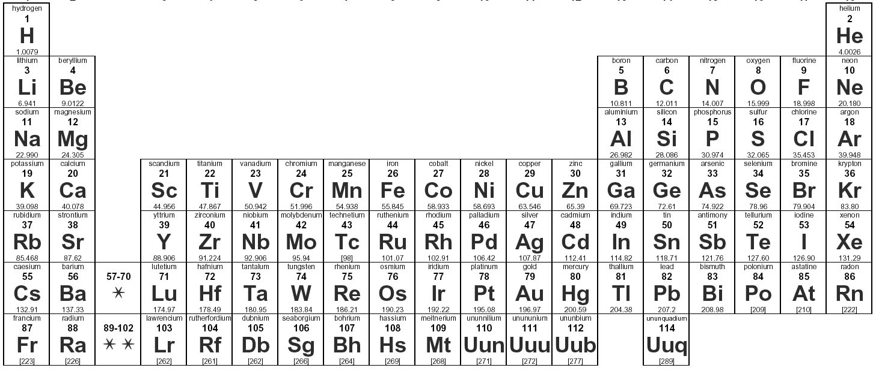
Review: What is the pattern for ion formation on the periodic table?
+1
1
8
1A
+2
+3
-3
-2
-1
18B
2
3
4
5
6
7
2A
2
13A 14A 15A 16A 17A
3B 4B 5B 6B 7B 8B 9B 10B 11B 12B

Slide 29
A. Ionic Compound Formulas
Write the element symbol AND ION CHARGE for the metal first
Write the element symbol AND ION CHARGE for the nonmetal
Criss-cross the numbers - NOT the charges
Example: Magnesium chloride
Mg⁺² Cl⁻¹

Slide 30
A. Ionic Compound Formulas
Write the element symbol AND ION for the metal first
Write the element symbol AND ION for the nonmetal
Criss-cross the numbers NOT the charges
Example: Magnesium chloride
Mg⁺² Cl⁻¹

Slide 31
A. Ionic Compound Formulas
Write the element symbol AND ION for the metal first
Write the element symbol AND ION for the nonmetal
Criss-cross the numbers NOT the charges
Example: Mg and Cl
Mg⁺² Cl⁻¹
1
2

Slide 32
A. Ionic Compound Formulas
Write the element symbol AND ION for the metal first
Write the element symbol AND ION for the nonmetal
Criss-cross the numbers NOT the charges
Example: Mg and Cl
Mg⁺² Cl⁻¹
= Mg₁Cl₂ = MgCl₂
1
2

Slide 33
Practice
Write the formula for the following ionic compounds:
Lithium oxide
Aluminum oxide
Magnesium nitride

Slide 34
Practice
Write the formula for the following ionic compounds:
Lithium oxide Li₂O
Aluminum oxide
Magnesium nitride

Slide 35
Practice
Write the formula for the following ionic compounds:
Lithium oxide Li₂O
Aluminum oxide Al₂O₃
Magnesium nitride

Slide 36
Practice
Write the formula for the following ionic compounds:
Lithium oxide Li₂O
Aluminum oxide Al₂O₃
Magnesium nitride Mg₃N₂

Slide 37
B. Ionic Compound with Transition Metals
Example: Cobalt (II) fluoride
Write the metal ion with charge
Use the roman numeral for the charge
Cobalt has a +2 charge
Write the nonmetal ion
Crisscross the numbers

Slide 38
Transition Metal Practice
Write the formula for the following compounds:
Cobalt (II) fluoride
Iron (III) bromide
Lead (IV) sulfide

Slide 39
Transition Metal Practice
Write the formula for the following compounds:
Cobalt (II) fluoride = CoF₂
Iron (III) bromide
Lead (IV) sulfide

Slide 40
Transition Metal Practice
Write the formula for the following compounds:
Cobalt (II) fluoride = CoF₂
Iron (III) bromide = FeBr₃
Lead (IV) sulfide

Slide 41
Transition Metal Practice
Write the formula for the following compounds:
Cobalt (II) fluoride = CoF₂
Iron (III) bromide = FeBr₃
Lead (IV) sulfide = Pb₂S₄

Slide 42
C. Covalent Compound Formulas
Write the symbol for each element
Use the prefix to determine how many atoms you have and write as a subscript
# of atoms | prefix
1 | mono-
2 | di-
3 | tri-
4 | tetra-
5 | penta-
6 | hexa-

Slide 43
Example
Covalent Compound = Carbon Tetrachloride
What are the two elements involved?
2. What are the symbols for each element?
3. How many atoms do I have of the first element?
4. How many atoms do I have of the second element?
5. Final answer?

Slide 44
Example
Covalent Compound = Carbon Tetrachloride
What are the two elements involved?
Carbon and Chlorine
2. What are the symbols for each element?
3. How many atoms do I have of the first element?
4. How many atoms do I have of the second element?
5. Final answer?

Slide 45
Example
Covalent Compound = Carbon Tetrachloride
What are the two elements involved?
Carbon and Chlorine
2. What are the symbols for each element? C, Cl
3. How many atoms do I have of the first element?
4. How many atoms do I have of the second element?
5. Final answer?

Slide 46
Example
Covalent Compound = Carbon Tetrachloride
What are the two elements involved?
Carbon and Chlorine
2. What are the symbols for each element? C, Cl
3. How many atoms do I have of the first element? 1
4. How many atoms do I have of the second element?
5. Final answer?

Slide 47
Example
Covalent Compound = Carbon Tetrachloride
What are the two elements involved?
Carbon and Chlorine
2. What are the symbols for each element? C, Cl
3. How many atoms do I have of the first element? 1
4. How many atoms do I have of the second element? 4
5. Final answer?

Slide 48
Example
Covalent Compound = Carbon Tetrachloride
What are the two elements involved?
Carbon and Chlorine
2. What are the symbols for each element? C, Cl
3. How many atoms do I have of the first element? 1
4. How many atoms do I have of the second element? 4
5. Final answer? CCl₄

Slide 49
Snappy Practice!
In the next 4 minutes, use your notes to write the formula for the following covalent compounds:
1. Carbon Dioxide
2. Triphosphorus Monochloride
3. Dinitrogen Trichloride
4. Nitrogen Dioxide

Slide 50
Snappy Practice!
In the next 4 minutes, use your notes to write the formula for the following covalent compounds:
1. Carbon Dioxide = CO₂
2. Triphosphorus Monochloride =
3. Dinitrogen Trichloride =
4. Nitrogen Dioxide =

Slide 51
Snappy Practice!
In the next 4 minutes, use your notes to write the formula for the following covalent compounds:
1. Carbon Dioxide = CO₂
2. Triphosphorus Monochloride = P₃Cl
3. Dinitrogen Trichloride =
4. Nitrogen Dioxide =

Slide 52
Snappy Practice!
In the next 4 minutes, use your notes to write the formula for the following covalent compounds:
1. Carbon Dioxide = CO₂
2. Triphosphorus Monochloride = P₃Cl
3. Dinitrogen Trichloride = N₂Cl₃
4. Nitrogen Dioxide =

Slide 53
Snappy Practice!
In the next 4 minutes, use your notes to write the formula for the following covalent compounds:
1. Carbon Dioxide = CO₂
2. Triphosphorus Monochloride = P₃Cl
3. Dinitrogen Trichloride = N₂Cl₃
4. Nitrogen Dioxide = NO₂

Slide 54
In Summary…
After your notes, write the following heading and answer the questions in complete sentences :
Summary
What was the main idea of today’s lesson?
What are three things that you learned?
What is one area you struggled with?

